Slide 1


Visionary Course - Energy AI
Week 11
May 17, 2022
Giwon Sur

Slide 2


https://view.kentech.ac.kr
Week 11b – Interactive regression for road following on Jetson Nano

Slide 3
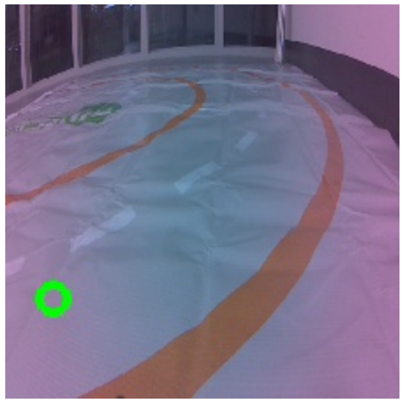
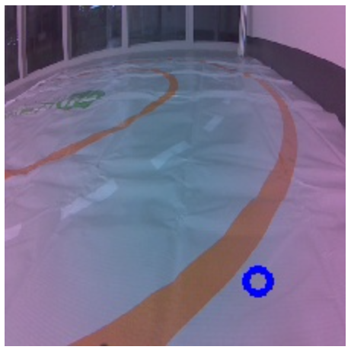
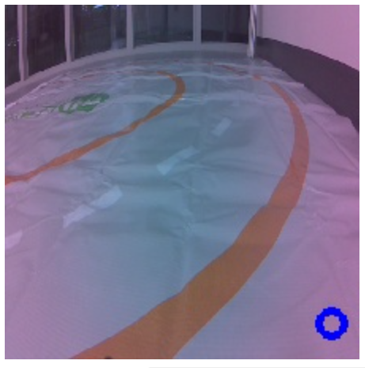
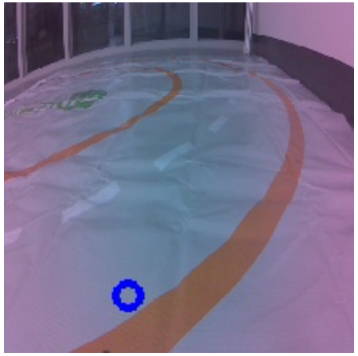
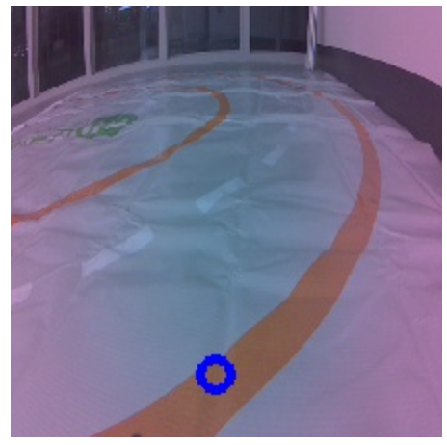
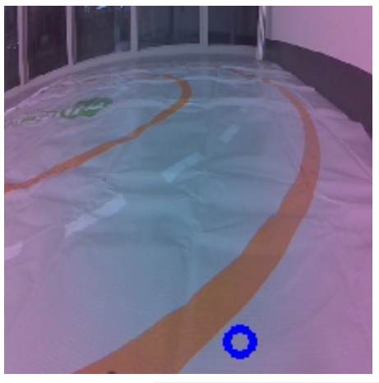

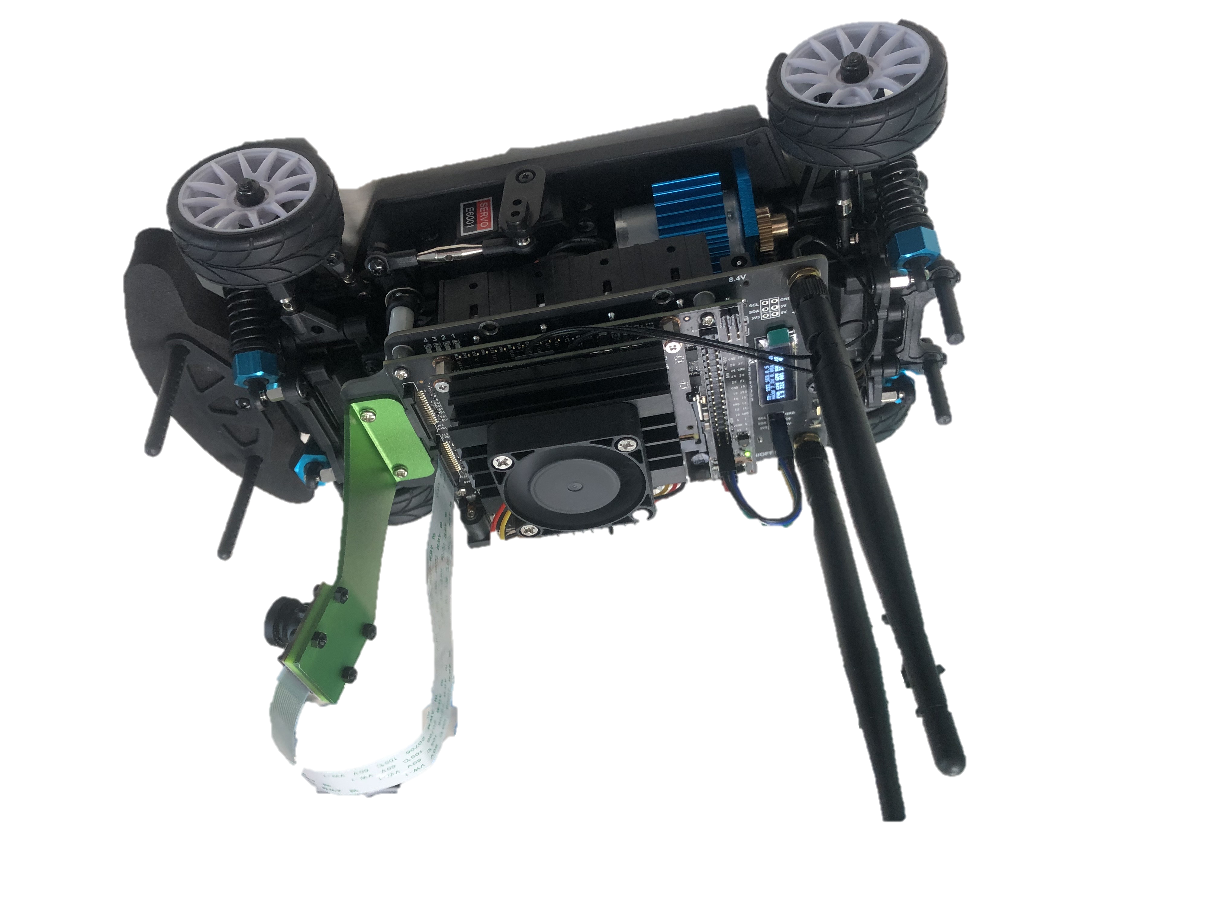
JetRacer: Let's continue autonomous driving!
Today we will train model on the road with 2D-lined track.
Train model!
Training Step #5
Training Step #4
Training Step #2
Training Step #3
Training Step #1
Green point
= Human’s annotation
= Ground Truth (GT)
Blue point
= Model’s output
= Prediction
Workspace:
“localhost:8888/lab/tree/jetracer/notebooks/interactive_regression.ipynb”

Slide 4
JetRacer: Let's continue autonomous driving!
Input image
Output:
pixel coordinate (x, y)
AI Model
Where to go?
Steering!
Deep Learning!
Controller

Slide 5
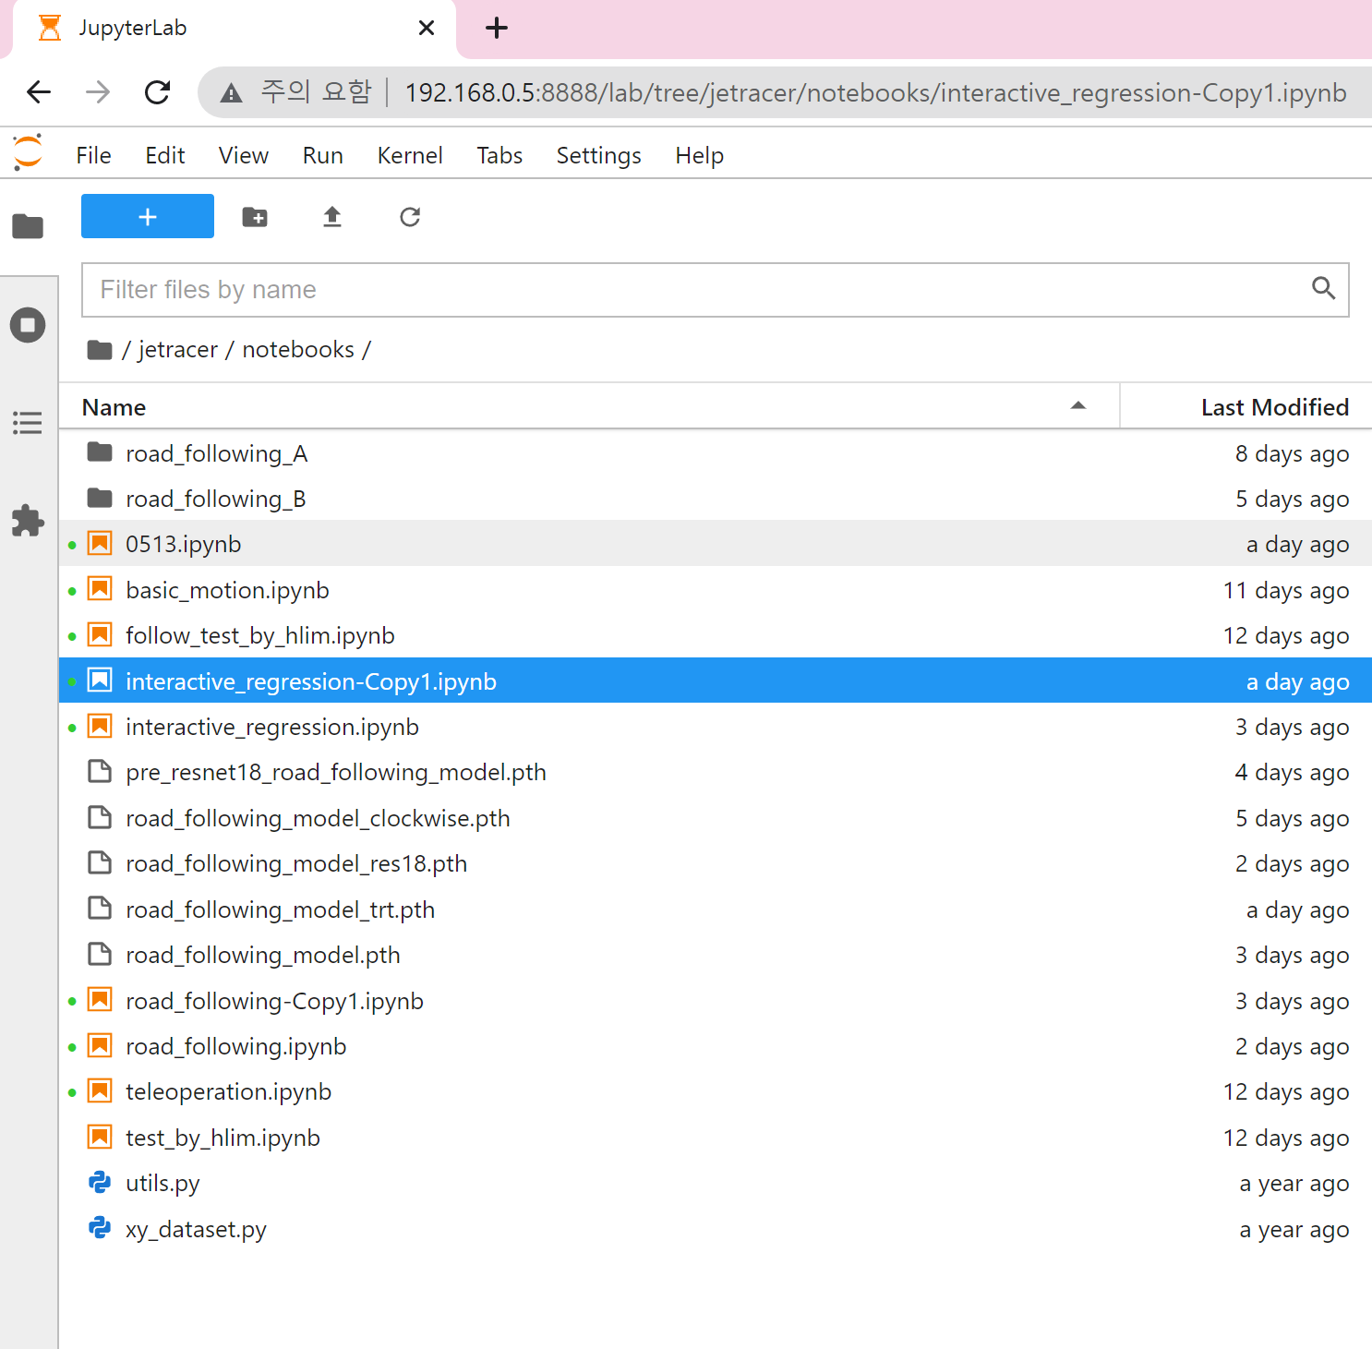
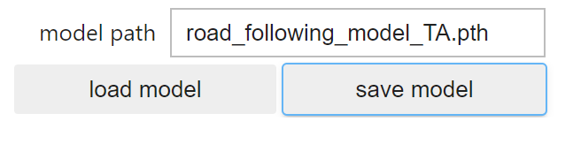
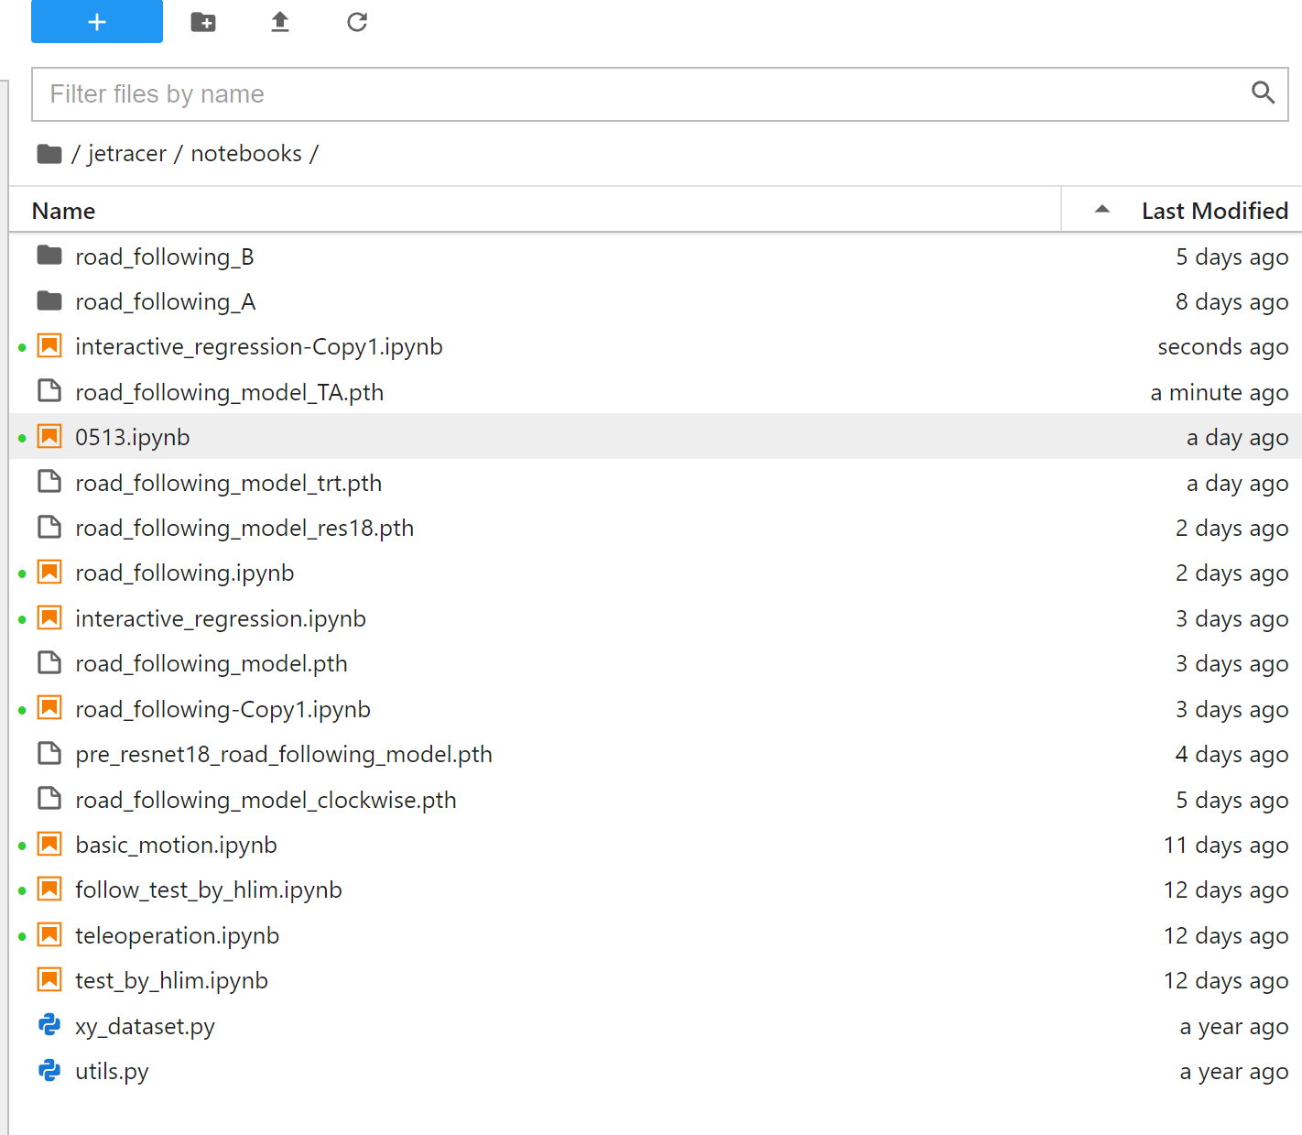
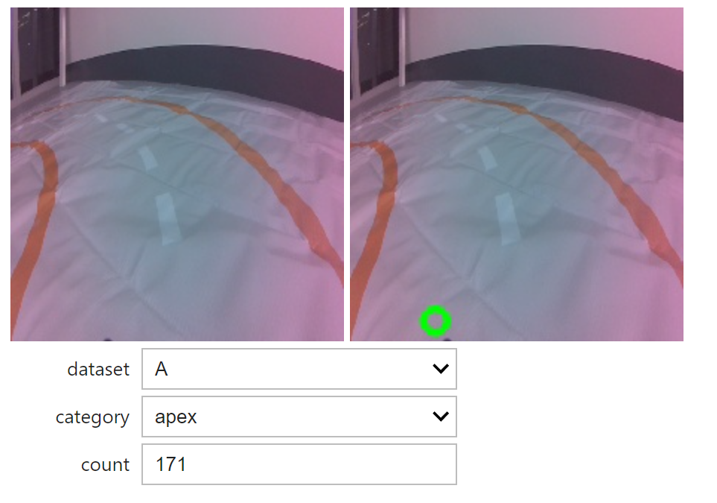
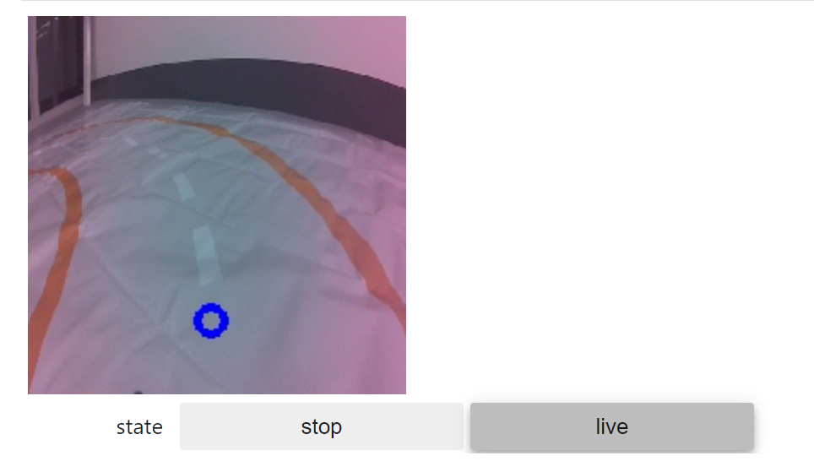
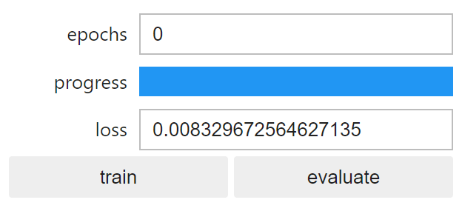
Overview of interactive_regression.ipynb
1
3
Composite dataset
Make model
2
4
Train & evaluate
Collect data

Slide 6
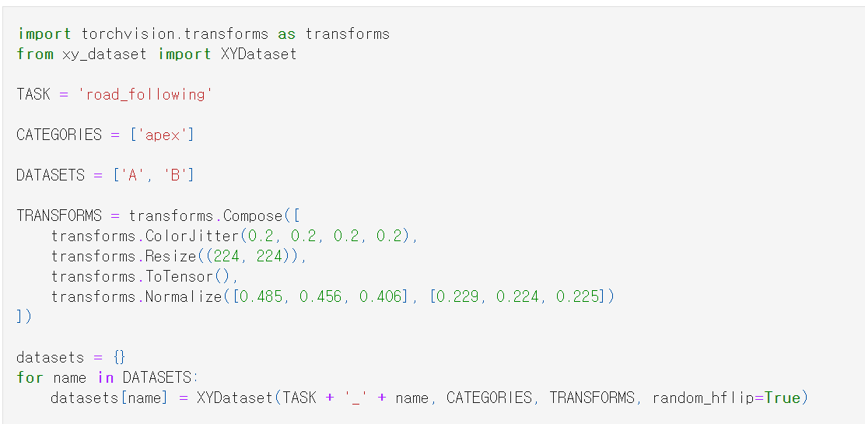
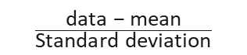
1. Composite dataset
Data augmentation
brightness, contrast, saturation, hue
mean
standard
deviation
$$\frac{\text{data}\text{ − }\text{mean}}{\text{Standard} \text{deviation}}$$
Load data if it exists

Slide 7
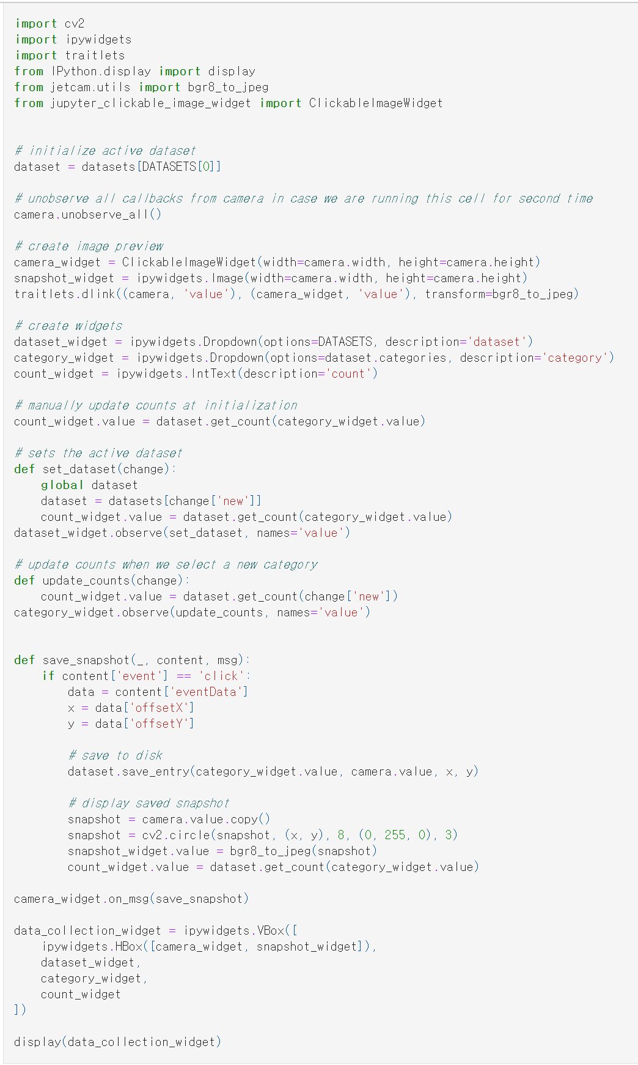
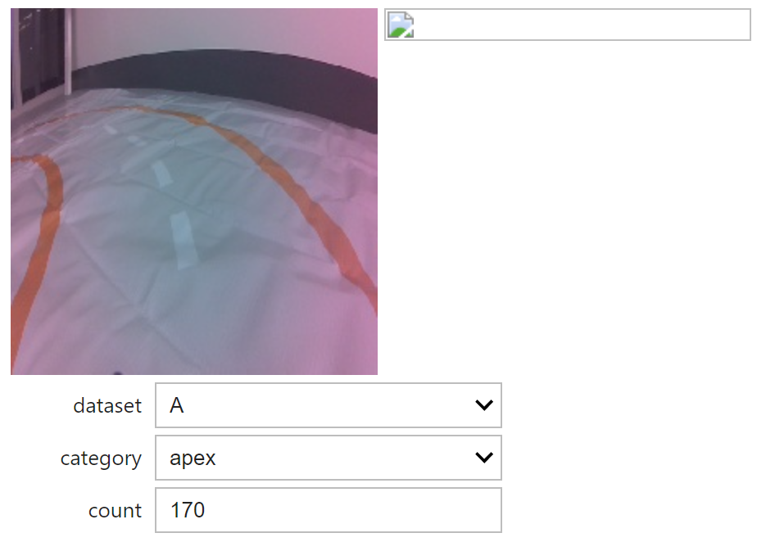
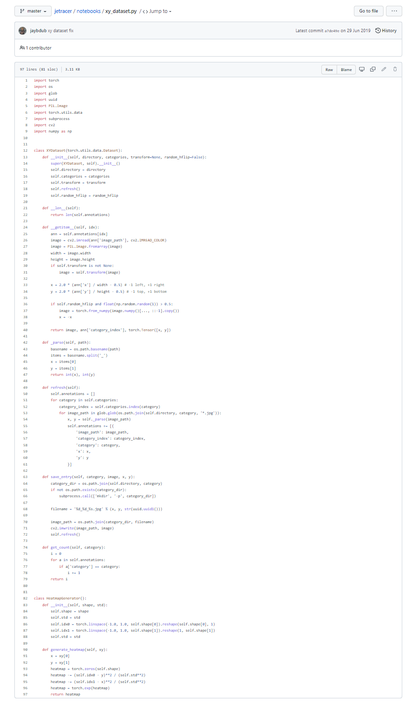
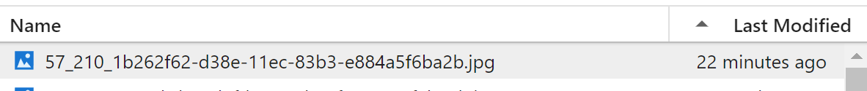
2. Collect data
Count accumulated snapshot
x
y
Saved snapshot get coordination in the file name

Slide 8
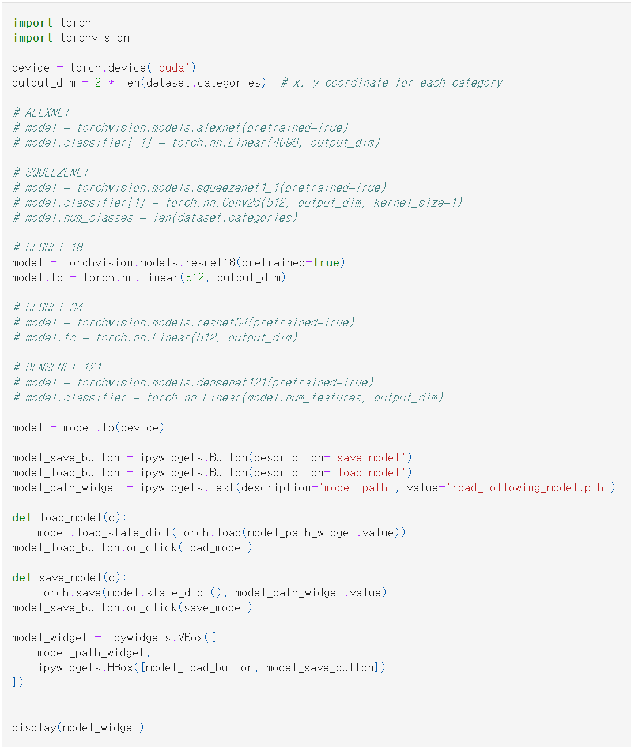
3. Define model
Declare specific model
(resnet18 here)
Set output dim’s as 2
Load model to GPU
Model’s name
Make widgets for
loading and saving model

Slide 9
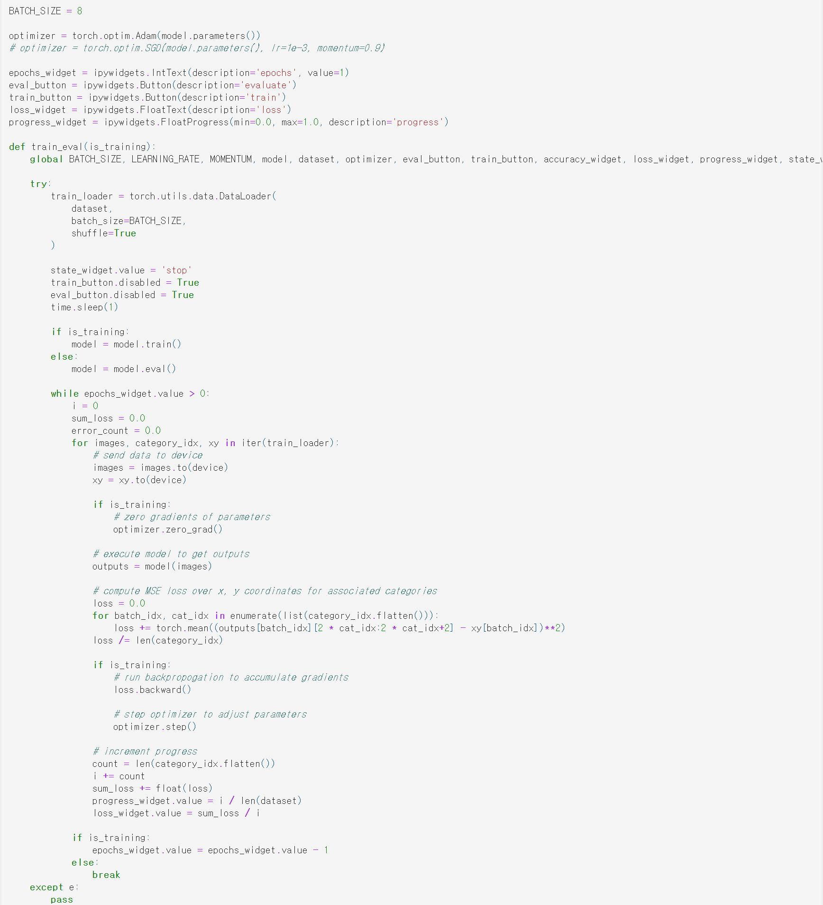
4. Train & evaluation

Slide 10
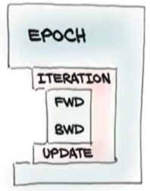
4. Train & evaluation
Epoch
Number of iterations over the entire dataset
Iteration
Mini-batch iterations
Forward
Predict output
Calculate loss
Backward
Calculate gradients and update the model (back-propagation)
Dataset: 1000 images
(batch size = 100)
. . .
Epoch:
One Epoch is when an ENTIRE dataset is passed forward and
backward through the neural network only ONCE.
Batch size:
Total number of training examples present in a single batch.
Iteration:
The number of passes to complete one epoch.
100
100
100
1-iter
2-iter
10-iter
1-epoch
Notes:
Training mechanism은 다음과 같다 (우측 피겨 팝업)
Epoch가 전체를 감싸고 있고 한 이포크안에 Iteration이 여러 번 돌면서 모델 포워드와 백워드를 반복한다.
그렇다면 Epoch와 Iteration은 무얼 의미할까? (아래쪽 Epoch, Batch, Iteration 텍스트 팝업)
Epoch is ~
Batch size is ~
Iteration is ~
Let’s see the details of code here.
The blue box shows the Epoch loop. This is number of iterations over the entire dataset (Epoch 팝업)
The green box ~ (Iteration 팝업)
The yellow boxes are ~ (FWD 텍스트 팝업)
The red box is ~ (BWD 텍스트 팝업)

Slide 11
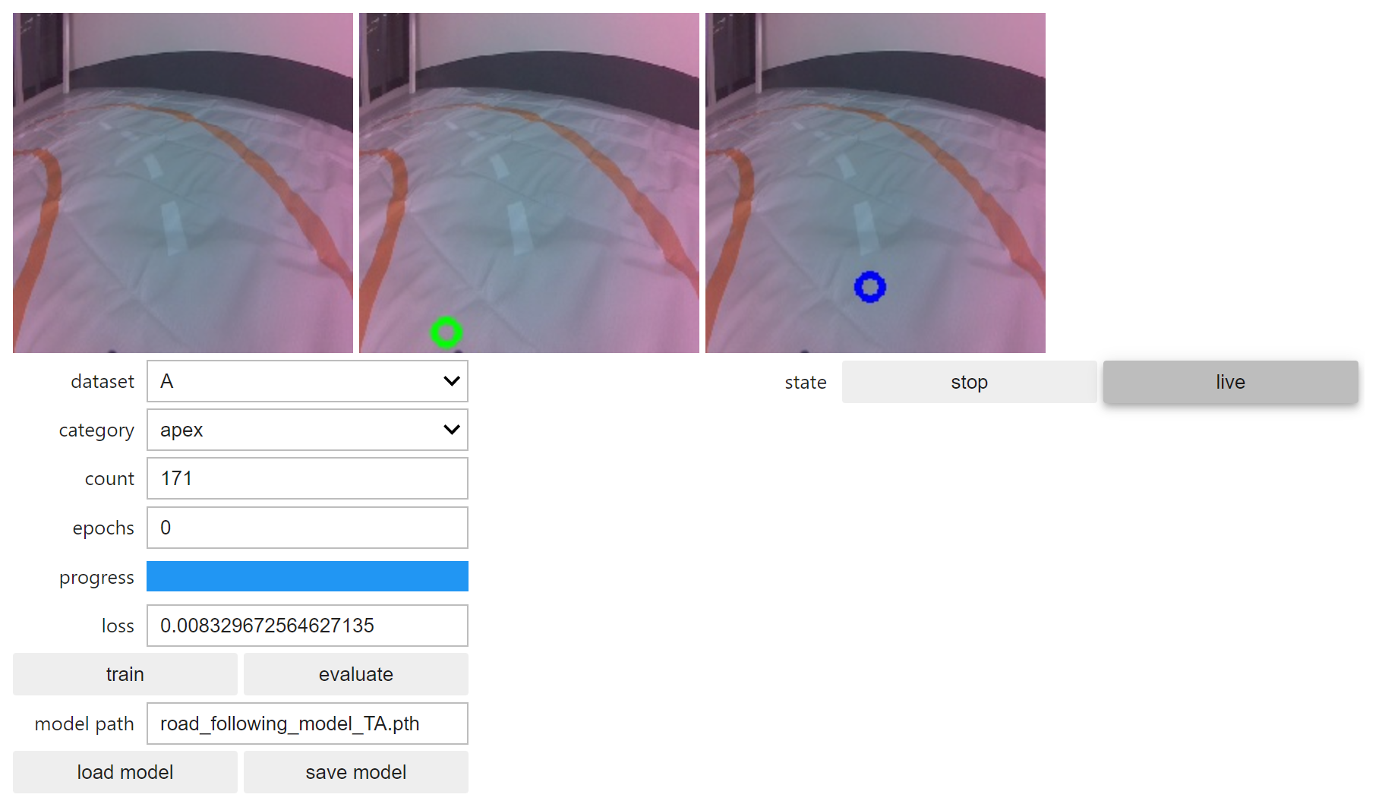
4. Train & evaluation
Don’t forget
to save!

Slide 12
Experiments (Submit the report by 05/26 11:59PM )
Run interactive regression.
Q.1.1. Collect data in ‘A’ and train the model.
Q.1.2. Repeat collection and training and evaluation alternatively until the count
no larger than 30.
Q.1.3. Save the model.
Run interactive regression with more data in another dataset with a different model.
Q.2.1. Collect data in ‘B’ and train the model with a different named model from 1.
Q.2.2. Repeat collect data and training and evaluation alternatively until the count becomes 150~200.
Q.2.3. Save the model.
Change the batch size and epoch and train the model
Q.3.1. Set batch size (original 8) to 4 or 16. and train the model. Can you observe the training time is different from 2?
Q.3.2. Set epoch size 5 and train. Observe the loss changes and evaluation result in the blue circle.
Q.3.3. Again, set epoch size 10 and train. Observe the loss changes and evaluation results in the blue circle. Compared to Q.3.2. how the result change?

Slide 13
Experiments (Submit the report by 05/26 11:59PM )
Run the trained models.
Q.4.1. With the trained models, run the road following.
Q.4.2. When observing the performance, which one is better? ( trained with 30 or 150~200)
Q.4.3. Run the better model, and compare the model with “road_following_model_gwsur.pth”
Train the model outside of the track.
Q.5.1. Place the car outside of the lane but head to the track.
Q.5.2. With the trained model, run the road following. Does the car get into the lane?
Q.5.3. If the car keeps moving outside, train the model.
Q.5.4. Place the car inside of the lane but head outside the track.
Q.5.5. With the trained model, run the road following. Does the car change the steering into the lane?
Q.5.6. If the car keeps moving outside, train the model.

